Slide 1
Magnet Product
Dongguan Keneng International Trading Co.,Ltd

Slide 2
ABOUT
US
Some brief introduction of our company, including: company profile, our advantages, our equipment.

Slide 3
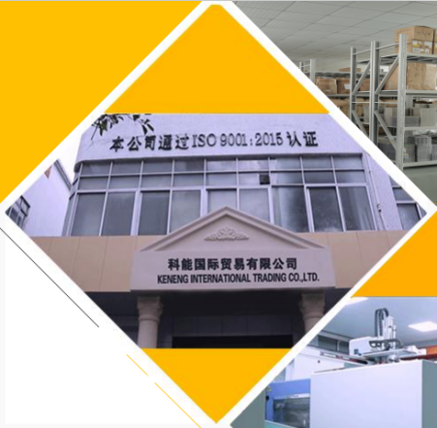
COMPANY PROFILE
Dongguan Keneng International Trading Co., Ltd is a subsidiary of Dongguan Keyu Plastic Hardware Co., Ltd., and is one of the most successful precision injection mold companies in China. We have 20 years designing, researching and developing, manufacturing history of magnets, screws, springs, and other lathe parts, stamping parts, battery holders. Since the establishment of the company in 2005, we built the battery holder factory in 2011, and built the hardware factory in 2018. While two Hong Kong companies have been established in 2013 and 2018. In case of the export business increasing rapidly, we built Keneng International Trading Company to do foreign trade business of all products for whole group.

Slide 4
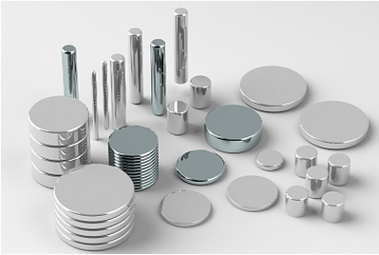
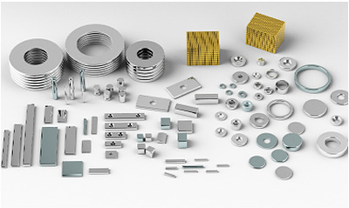
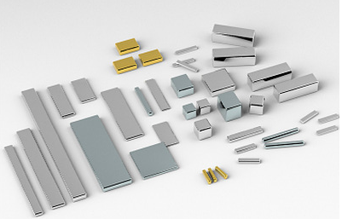


WHY CHOOSE US
Source Manufacturer
Quality
Service
Located in rare earth raw material processing center.
Factory area： 4500 square meters.
Equipment：75 machines.
History：15 years experienced in magnet industry.
Capacity：3000 tons one year.
Strictly QC from raw materials to Finished Product Packing
Have MSDS /ROHS/REACH/ISO 9001 certificates.
A number of inspection equipment to guarantee quality
Massive inventory of magnets
Prompt delivery and fast response.
Customized according to customer requirements.
Professional R&D team.

Slide 5
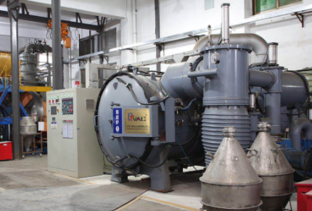
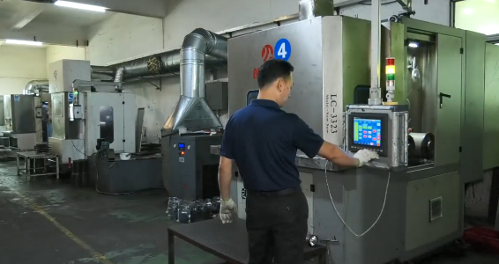
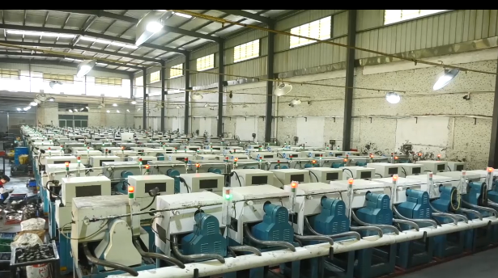
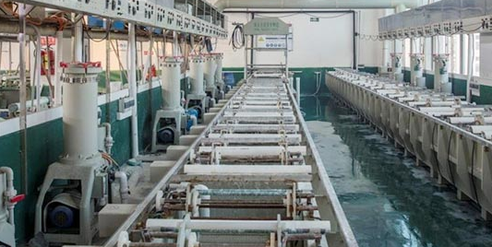
Production Equipment
Raw material Prodution
irregular parts processing
Slice device
Electroplate

Slide 6
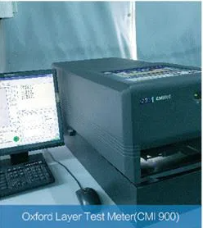
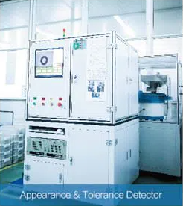
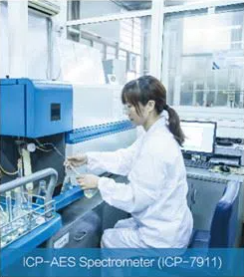
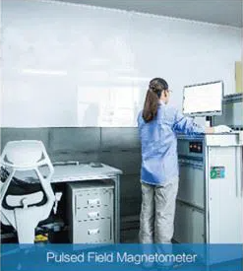
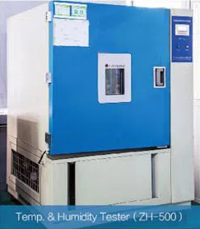
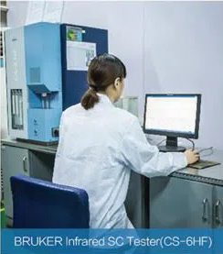
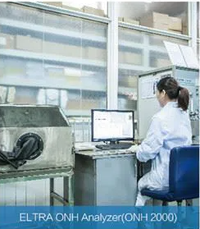
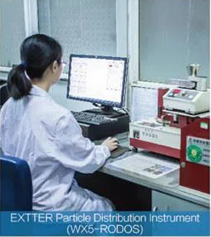
Inspection Equipment

Slide 7
PRODUCT
DISPLAY
Display of our product categories and introduction of some product industries

Slide 8
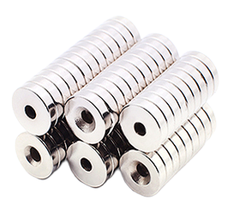
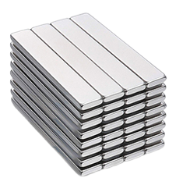
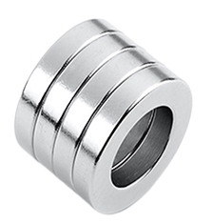
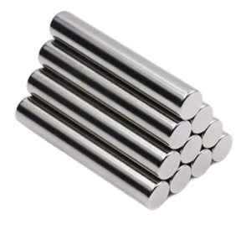
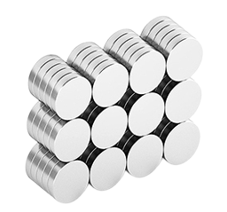
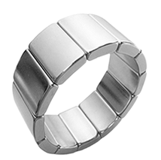
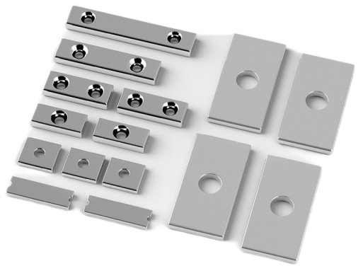
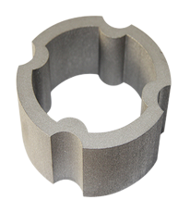
Classfication By shape (NdFeB)
Cylinder magnets Countersunk Block magnets Ring magnets
Disc magnets Arc magnets Rectangle with hole Special shaped

Slide 9
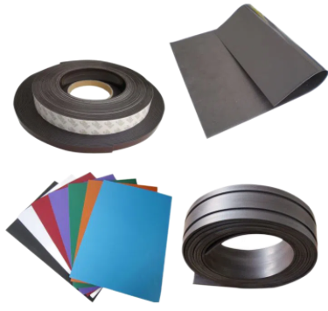
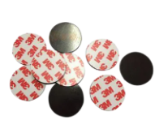
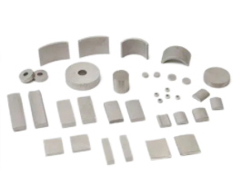
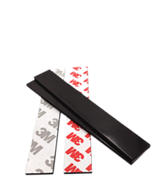
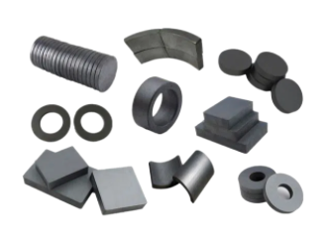
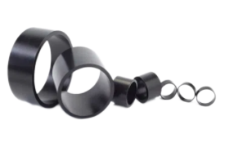
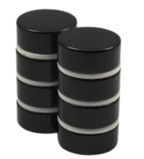
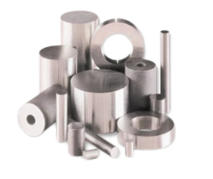
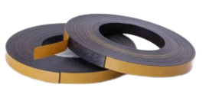
Classfication By Material
Samarium Cobalt
Ferrite Magnet
AlNiCo Magnet
Rubber Magnet
Bonded Magnet

Slide 10
COATING

Slide 11
PRODUCT
APPLICATION
Introduction to the wide range of applications of our products

Slide 12
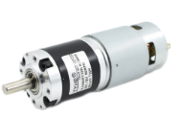
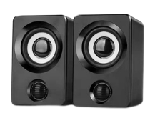






APPLICATION
Wireless charger
Electromobile
It is mainly used for iPhone magsafe wireless charger transmitting terminal.
Major used in Hall components for temperature sensors and automotive electronic sensors, magneto tubes, amplifiers, regulators, instrument lamps.
PMDC motor
It has considerable corrosion resistance and magnetic properties and high-temperature stability. Mainly used in servo motor, water pump, connector hungry sensor, instrument lamp.
Speakers
Widely used in permanent magnet motors, motors, loudspeakers, dry reed tubes, magnetic separators and adsorption devices .

Slide 13
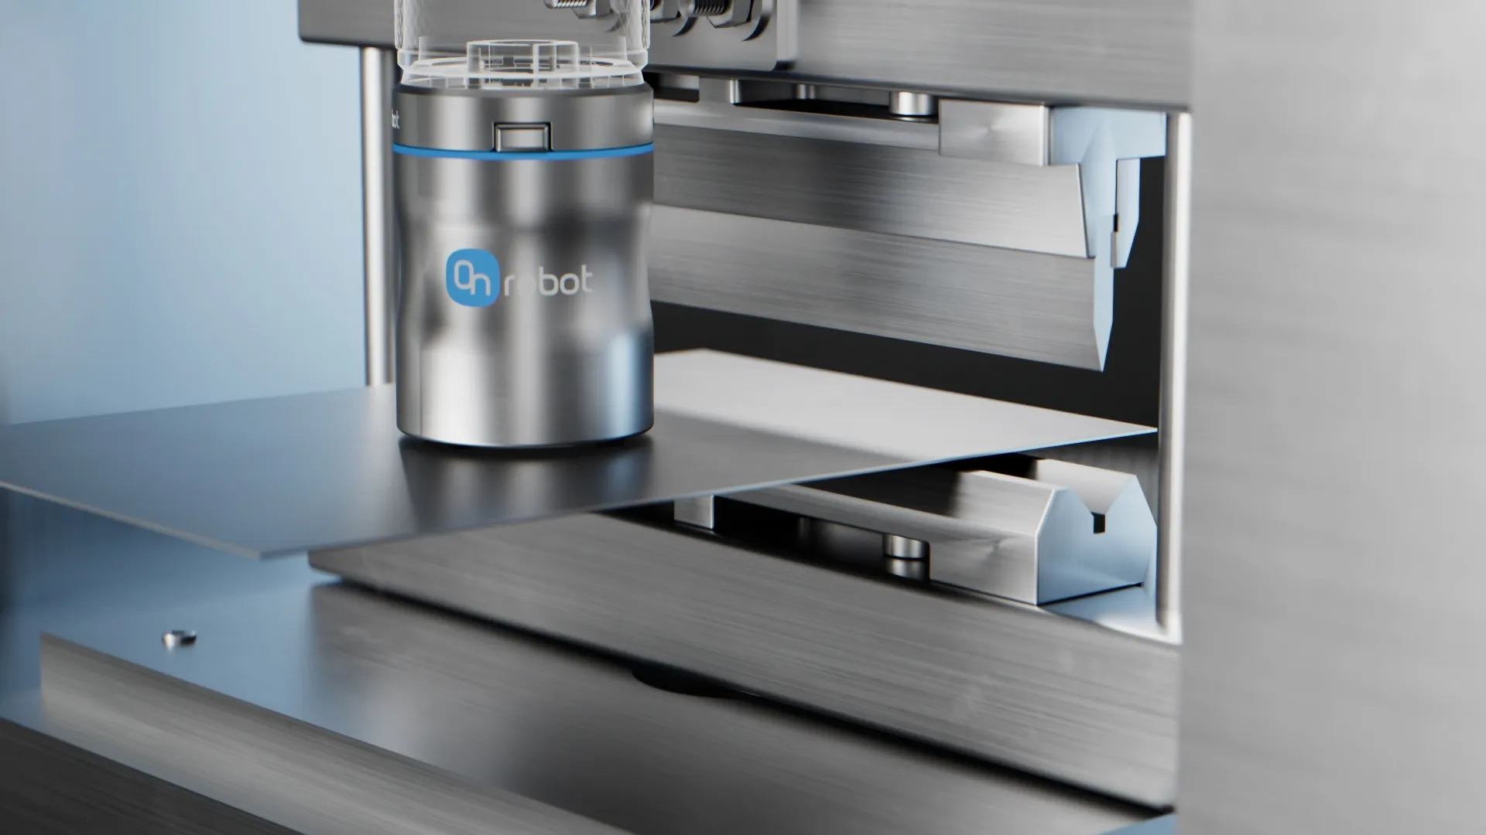
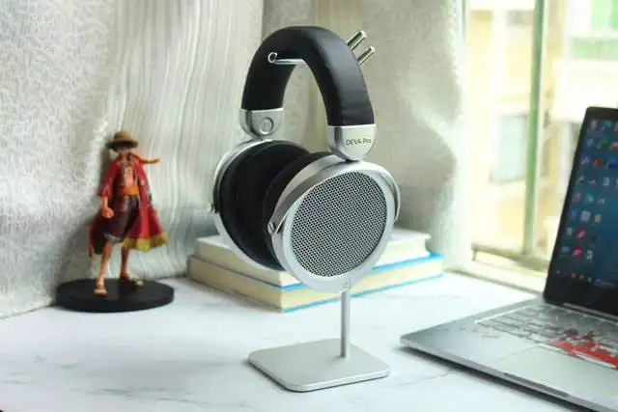
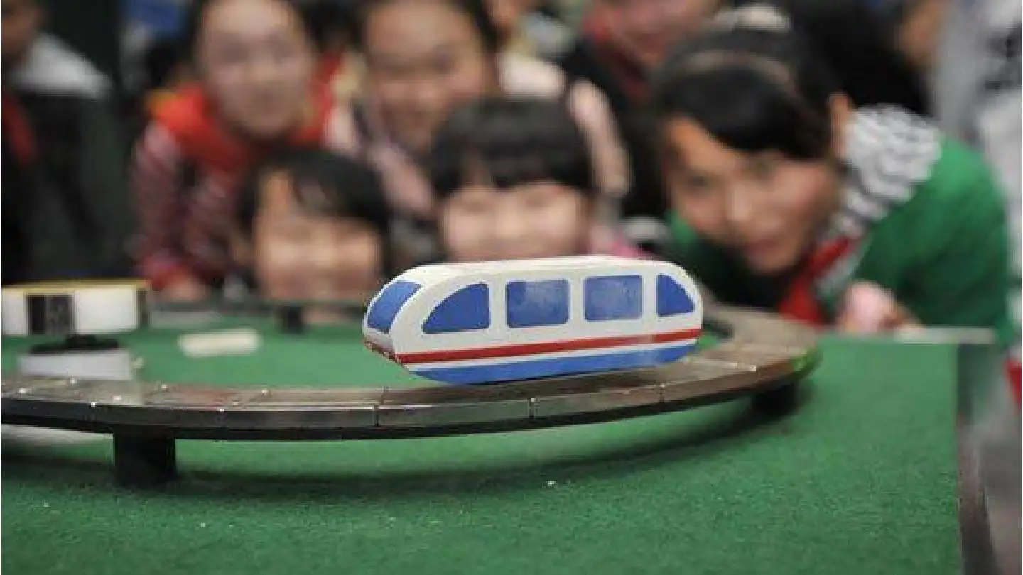
Magnetic component systems and products include motor activation, eddy current use, blood detection and separation, linear actuators, ignition timing systems, power meters, welding equipment, television monitors, sensors, sound speakers, magnetic resonance imaging, automotive, electronics, Biomedical, aerospace, film and software disk programming and erasing.

Slide 14
OUR
SERVICE
Introduction of our business scope and cooperative customers, as well as the services we can provide you

Slide 15




OUR SERVICE
We are one of the few permanent magnet manufacturers in the industry with a complete industrial chain. We can guarantee that the magnetic consistency of our products reaches more than 95% (the industry average is only 85%)
Automatically coating production lines-----Main coatings are Ni-Ni, Ni-Cu-Ni, Ni-Cu-Epoxy, Zn, Zn-Epoxy, P, Al, etc.
Customized magnets according to customer requirements. After sales problems, will respond within 24 hours.

Slide 16


GLOBAL RANGE
BUSSINESS SCOPE
Our magnet products are exported all over the world, Europe and America, Southeast Asia, the Middle East, Australia, Africa and so on.
FEEDBACK OF CUSTOMERS
Our products are not easy to be oxidized and have long-lasting magnetic.

Slide 17
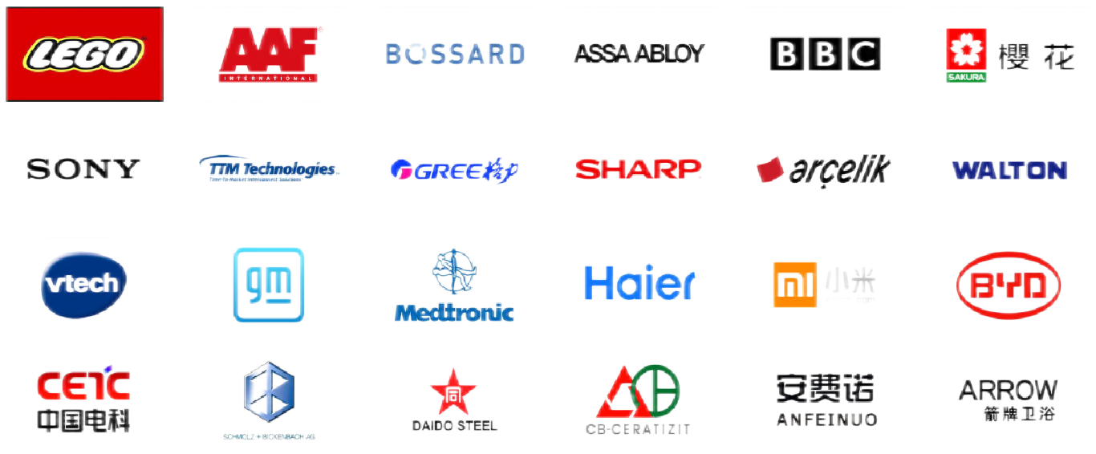
Company Partners

Slide 18
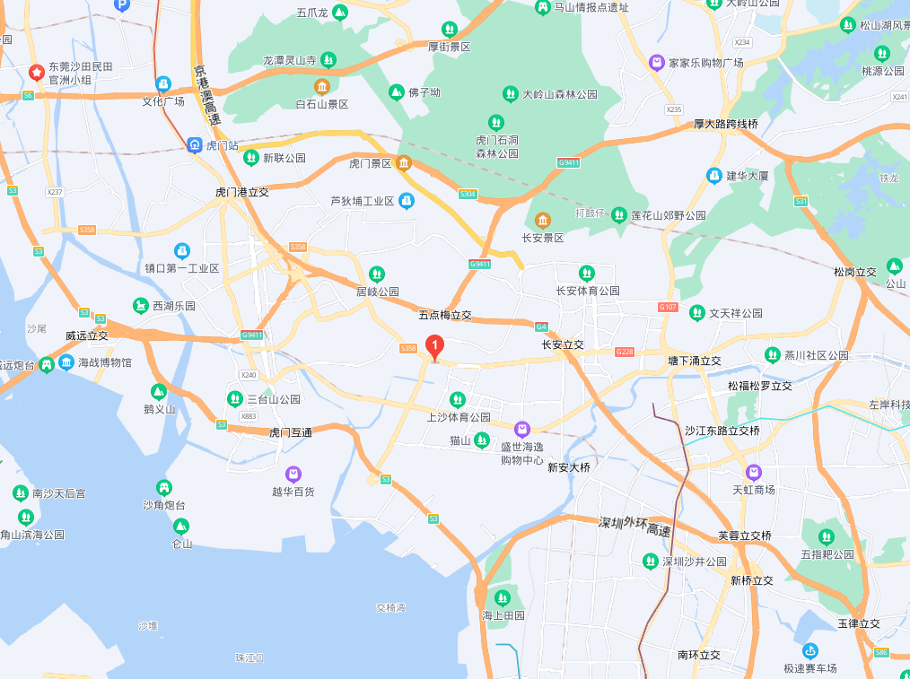




WELCOME CONTACT US
www.kenenghardware.com
+86-18102976656
WhatsApp: +86-13928607605
cheri@kenenghardware.com
No.9 Rongfeng Road , Shangsha ,Chang’an, Dongguan, Guangdong, China. 523867

Slide 19
Thank You!

